Slide 1
** Academic Integrity ** Incidents - Violations & Faculty Perceptions
Karen Hodges & Timothy Paul Cronan
Fall 2017

Slide 2
Academic Dishonesty
Academic dishonesty includes, but is not limited to, any act by which a student gains or attempts to gain an academic advantage for him/herself or another by misrepresenting his/her or another’s work or by interfering with the independent completion, submission, or evaluation of academic work.

Slide 3
Take Aways …
We continue to have an AI problem – But…
Faculty insights
AI Culture on Campus – we can we effect change – awareness, attitudes & perceptions
Information Systems – University of Arkansas 3

Slide 4
“Houston, we have a problem!”
Surveys continue to indicate that 60% - 65% of our students cheat
(Lang* reports 65% - 82%)
*Lang, James M. (2013). Cheating Lessons: Learning from Academic Dishonesty, (Harvard University Press, Cambridge, Massachusetts)
Information Systems – University of Arkansas 4

Slide 5
What has happened at UA…
More violations are reported (up significantly)
Academic Integrity Monitors (AIMs)
Faculty buy-in – (easy reports)
Student buy-in – (turn-ins)
Taken seriously on campus

Slide 6
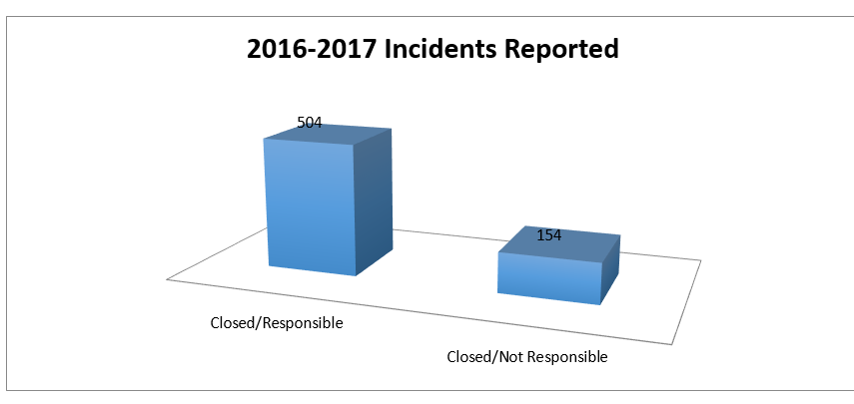

Slide 7
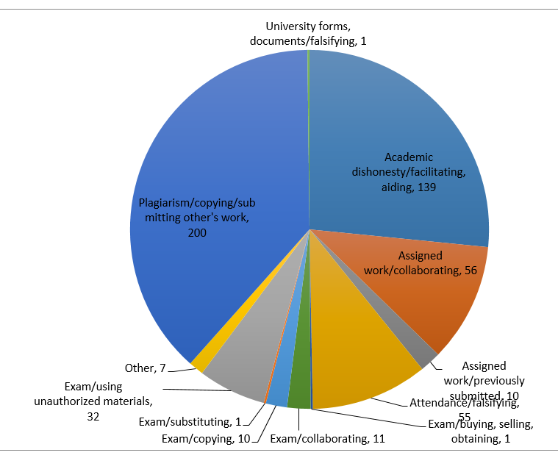

Slide 8
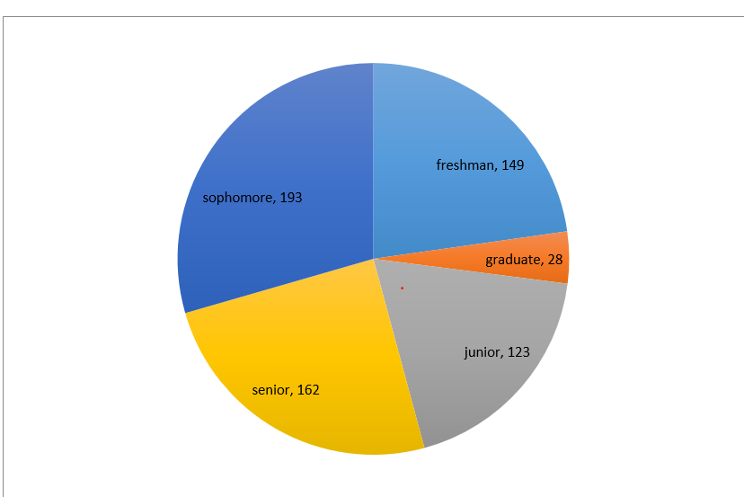

Slide 9
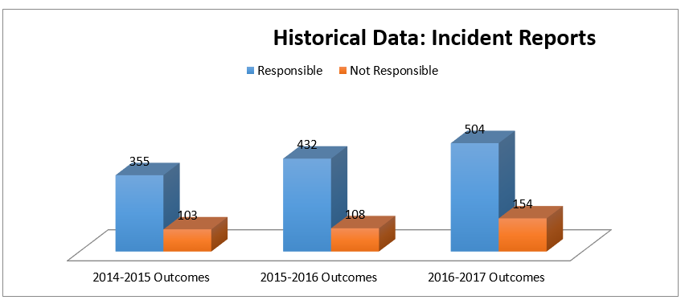

Slide 10
Appeals of AUAIB Decisions 2014-2017
2014-2015 9 student appeals
7 provost/chancellor upheld AUAIB decision
2 provost/chancellor overturned AUAIB decision
2015-2016 8 student appeals 2 faculty appeals
provost/chancellor upheld AUAIB decision in 7 student cases
provost/chancellor upheld AUAIB decision in 1 faculty case
2016- 2017 7 student appeals 1 faculty appeal
provost/chancellor upheld AUAIB decision in 3 student cases
provost/chancellor overturned AUAIB decision in faculty case

Slide 11
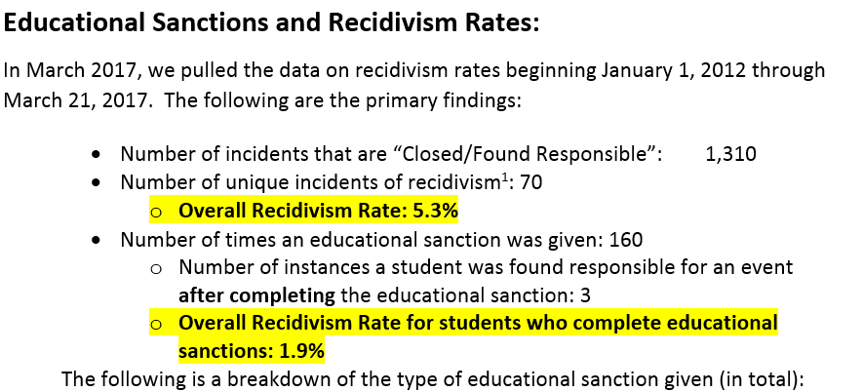

Slide 12
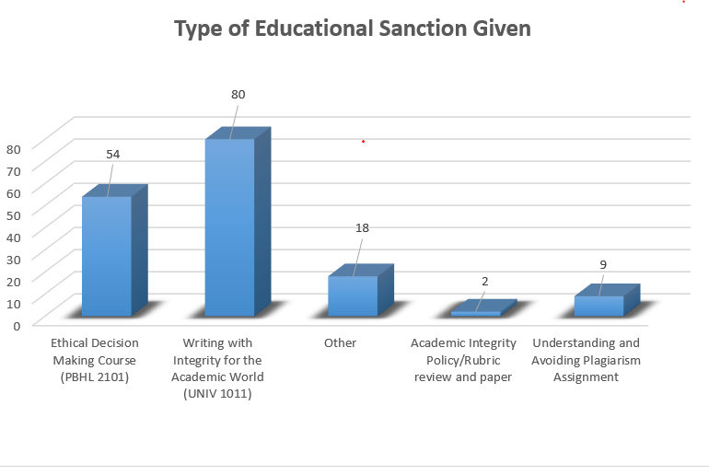

Slide 13
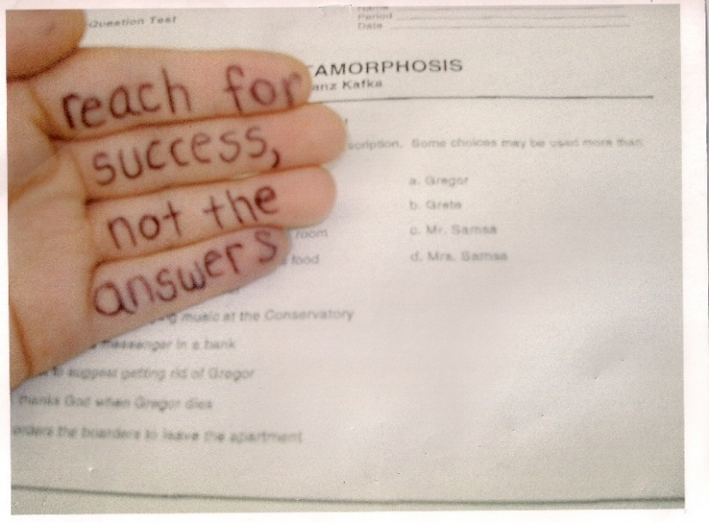
Motivation
People see success in their career is more important than ethics (Lawson 2004)
Image collected from http://p4cdn4static.sharpschool.com/UserFiles/Servers/Server_2296256/Image/AICMaci0001.jpg
Information Systems – University of Arkansas 13

Slide 14
Services Tempt Students
http://www.wetakeyourclass.com/
http://www.writemypapers.org/homework-writing/
http://www.allfreepapers.com/
http://schoolsolver.com/
http://www.homeworkmarket.com/
Information Systems – University of Arkansas 14

Slide 15
Some Faculty Perceptions
Timothy Paul Cronan

Slide 16
Faculty Perceptions: UA Fall 2017 n = 326
Bumpers College | 12.6%
Education College | 16.6%
Engineering | 11.0%
Faye Jones School | 1.2%
Fulbright College | 40.8%
Walton College | 12.3%
Other | 5.5%
Male | 46.8 %
Female | 53.2%
Teaching Assistant | 0.9 %
Instructor/Clinical | 31.3%
Assistant Professor | 20.6%
Associate Professor | 19.3%
Full Professor | 27.9%

Slide 17
Faculty Perceptions: UA 2017
 | Yes | --- | No
In the past five (5) years, have you had occasion to use UA’s Academic Integrity procedures for a violation that occurred in one (or more) of your class(es)? | 42.9% (140) |  | 57.1% (186)
1-Excellent; 2-Good; 3-Neither Good nor Bad; 4-Slightly Bad; 5-Bad | Excell / Good | --- | Bad
If you used UA’s Academic Integrity procedure, (139) please rate your experience with the process - | 63.3% (88) | 20.9% (29) | 15.8% (22)
1-Extremely Likely; 2-Likely; 3-Neither Likely nor Unlikely; 4-Unlikely; 5-Extremely Unlikely | Likely | --- | Unlikely
Hopefully, Academic Integrity violations do not (will not) occur in one of your classes in the future; however, if a violation should occur, please rate how likely that you would report the violation and utilize UA’s Academic Integrity process? | 82.6% -- 87.1% (121) | 9.9% -- 6.5% (9) | 7.5% -- 6.5% (9)
* All changes were Statistically Significant

Slide 18
Faculty Perceptions: UA 2017 1-Definitely Familiar; 2-Familiar; 3-Somewhat Familiar; 4-Neutral; 5-Somewhat Not Familiar; 6-Not Familiar; 7 - Completely Unaware
 | Familiar | --- | Not Familiar
Students’ familiarity with the university’s policy regarding plagiarism? | 63.3% | 7.5% | 29.2%
Students’ familiarity with how to properly cite works used within a paper? | 48.8% | 9.0% | 42.2%
Students’ familiarity with the university’s policy regarding cheating on exams? | 78.1% | 8.8% | 13.1%
Students’ familiarity with the university’s policy regarding sharing homework assignments (when asked not to)? | 52.0% | 13.2% | 34.8%
Students’ familiarity with the university’s policy regarding collaborating on assignments with other students (when asked not to)? | 51.3% | 12.9% | 35.8%
Faculty’s familiarity with the university’s Academic Integrity policy and procedures? | 75.2% | 10.5% | 14.2%
* All changes were Statistically Significant

Slide 19
Faculty Perceptions: UA 2017 1-Stongly Agree; 2-Agree; 3-Somewhat Agree; 4-Neither Agree nor Disagree; 5-Somewhjat Disagree; 6-Disagree; 7-Strongly Disagree
 | Agree | --- | Disagree
An academic integrity policy and process should largely be educational as opposed to punitive. | 52.9% | 10.8% | 36.3%
It is a faculty member’s responsibility to educate students who violate the policy and plagiarize, because they do not know how to cite sources properly. | 67.9% | 9.3% | 22.7%
Academic Integrity is primarily the responsibility of the student. | 72.9% | 10.2% | 16.9%
Academic Integrity is primarily the responsibility of the instructor/faculty member. | 39.8% | 15.4% | 44.8%
Academic Integrity is primarily the responsibility of the university administration. | 43.1% | 20.9% | 36.0%

Slide 20
Thank you!
Information Systems – University of Arkansas 20

