Slide 1

Transit and Parking Update and LPR Initiative
presented by Gary K. Smith
Director, Transit and Parking
September 13, 2017
Notes:
My name is Gary Smith and I’m the Director of Transit and Parking for the University.

Slide 2

Introduction
About Transit and Parking
New Parking Meters
LPR Initiative
Timing and Next Steps
Q & A

Slide 3
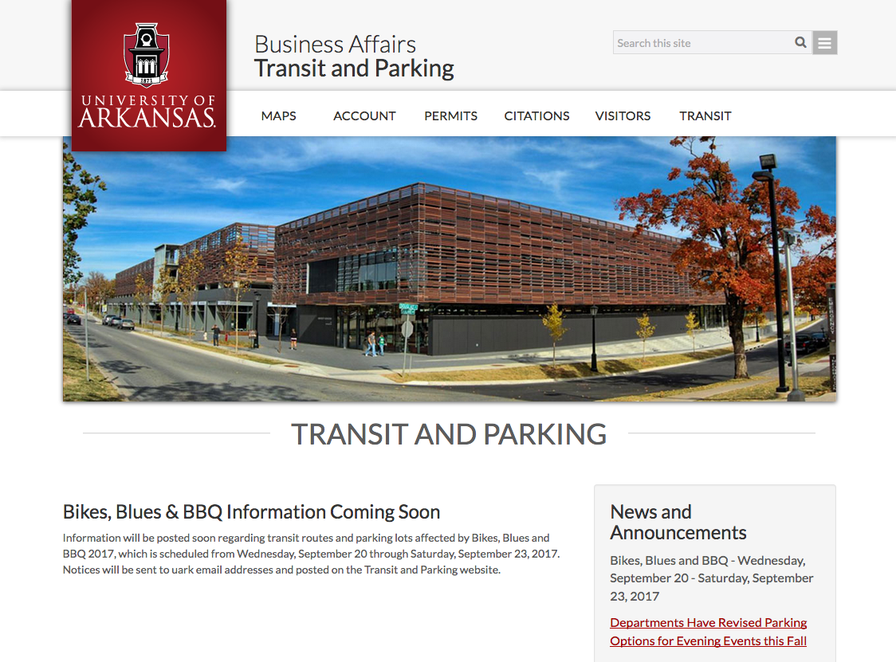
Transit and Parking Operations
- Razorback Transit Services
- Paratransit Services
- Parking Services
- Safe Ride
- Special Events
- Razorback Charters
- University Committees
Notes:
Transit and Parking - Operations consist of:
We operate:
Razorback Transit and Paratransit Services
Parking Services including Permits, Enforcement and Appeals
Safe Ride program – providing a late nigh ride home for students within the Fayetteville city limits
We operate parking for Special Events like football and basketball games
Charter bus service for campus departmental and events
and we serve on various University-wide Committees
Our website is at: parking.uark.edu

Slide 4
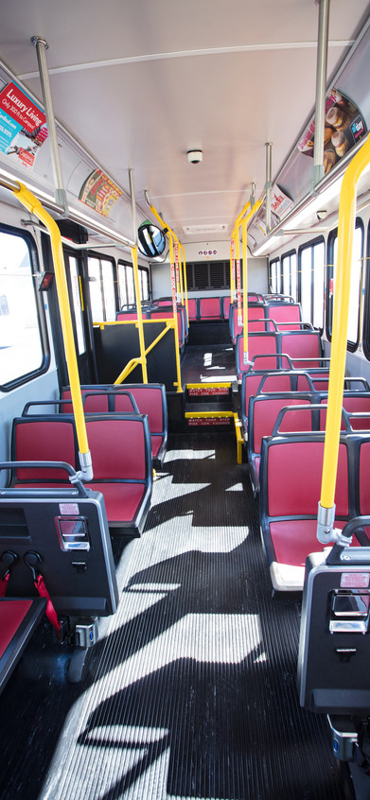
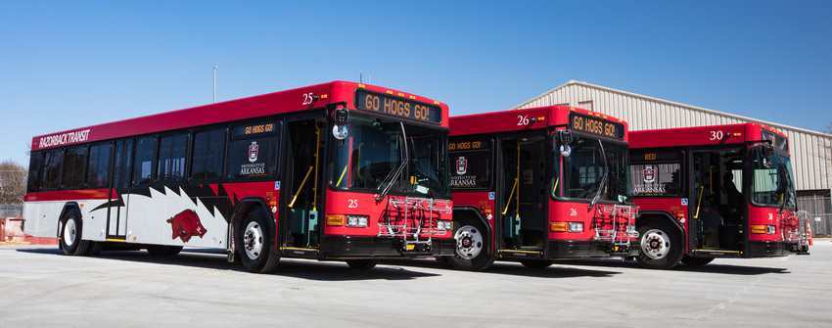
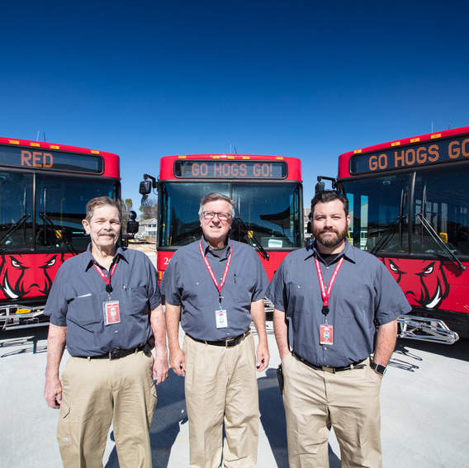
Transit Services
Notes:
About Transit Services:
federally funded, public mass transit system
receive a federal grant for part of the operational fees so we follow all the federal rules
open to the public - anybody can ride fare free

Slide 5
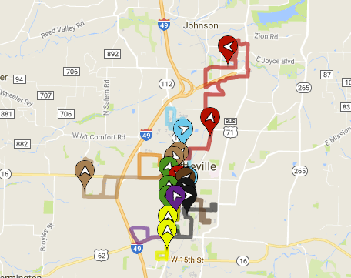
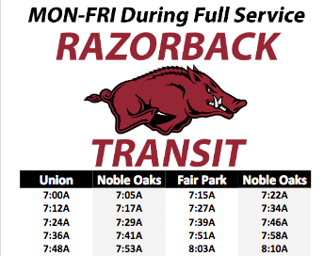
Razorback Transit Route Maps and Schedules
Notes:
We cover about half the city of Fayetteville
Our website will show the bus and bus stop locations in real time
Also available on the campus map webpage on your smartphone

Slide 6
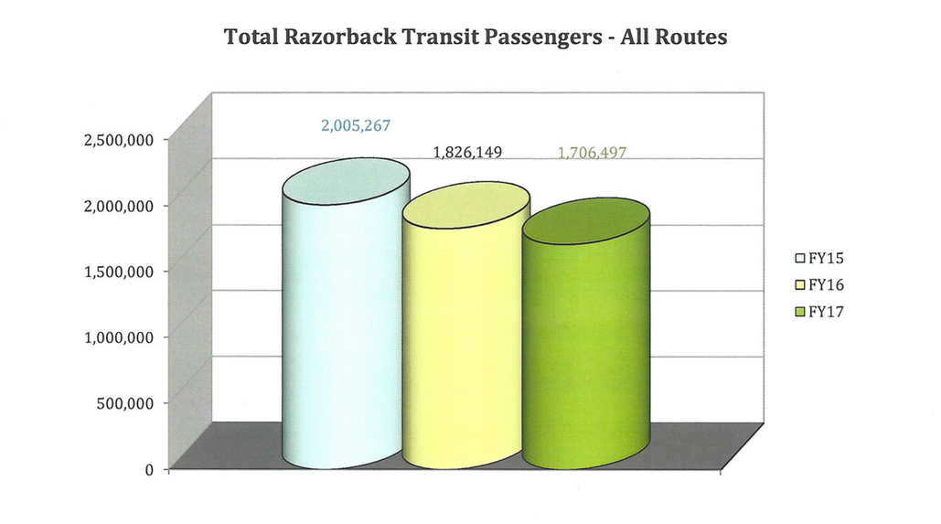
Razorback Transit Riders
Notes:
- 1.7 million riders last year

Slide 7
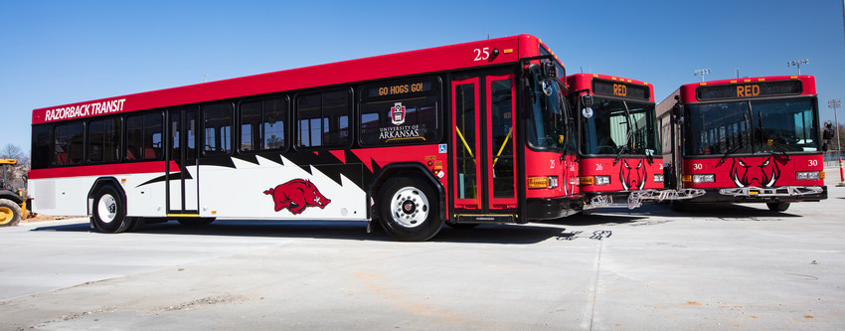
Transit Services
Notes:
Purchase 2-3 new buses annually at $405K each
Newest buses display our new branding. We are having the older buses repainted to match over the next few years

Slide 8
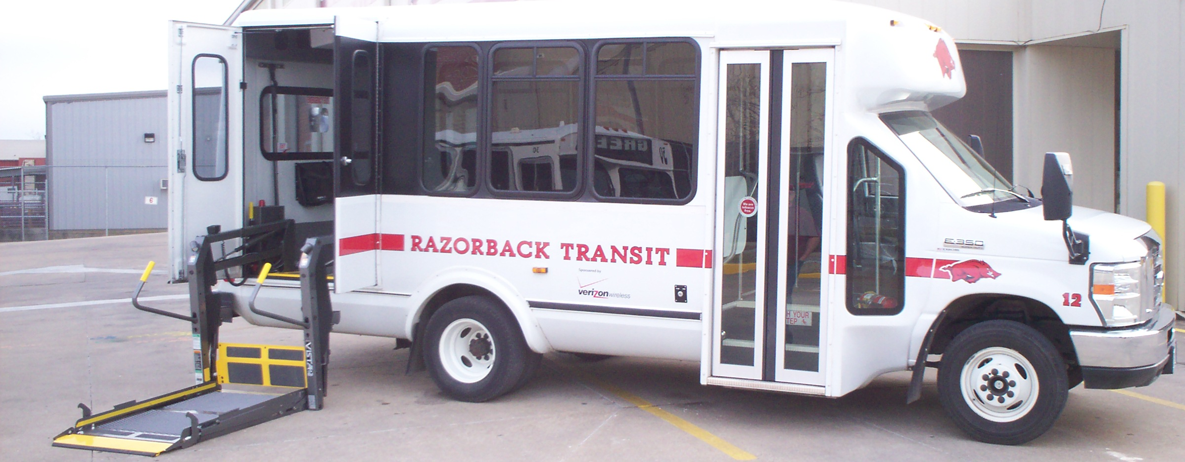
Paratransit Services
Notes:
Paratransit Services: If our fixed routes don’t work for you, we can offer paratransit service
For people with disability who cannot access fixed route stop or the fixed routes
Operates within ¾ of a mile of all of our fixed routes during the same hours
A person needs to be certified (which we can help you with that)
We use trip by trip eligibility
About 80% of paratransit passengers is not University-related (opposite of Transit services which is 80% University related)

Slide 9
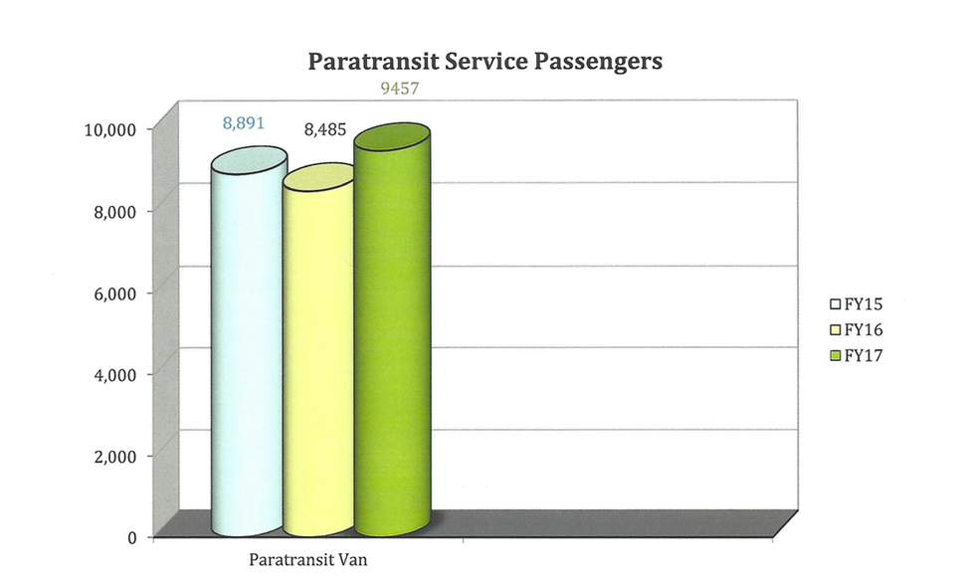
Paratransit Passengers in FY 2017
Notes:
About 9500 people rode Paratransit in FY17

Slide 10
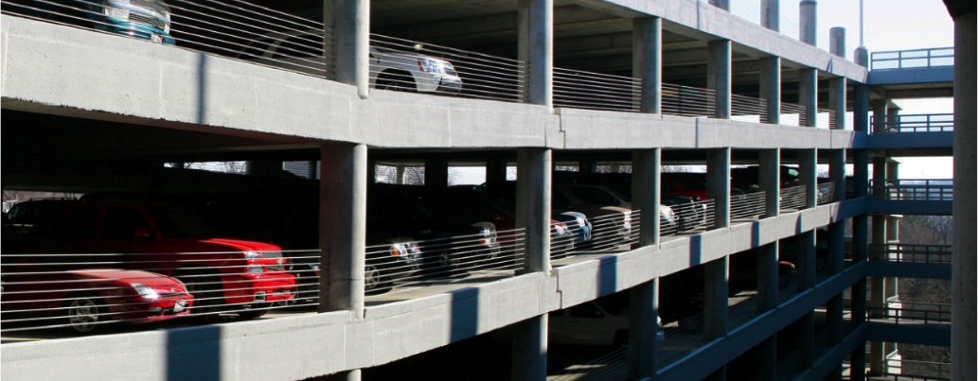
Parking Operations
Notes:
Parking Operations
Operated as an “Auxiliary” - the University does NOT fund parking
Revenue is from
permits
Meter fees and hourly parking
citations
special events
All of the revenue goes back into parking

Slide 11
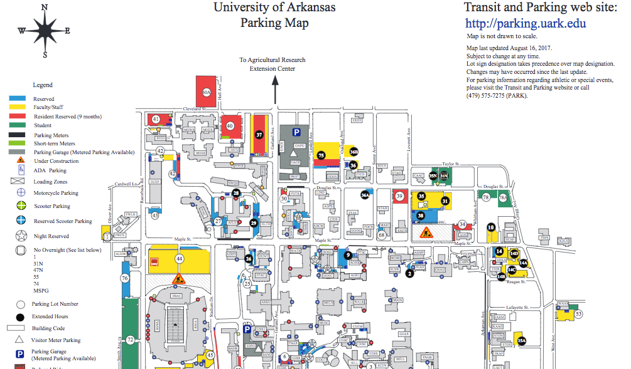
Parking Revenue and Costs
Notes:
Parking Revenue and Costs
All of the revenue goes back into parking
Currently, we are paying about $4MM per year in debt service on 3 existing parking garages
The Garland Garage costs about $32MM to construct
To build: Each surface parking space cost $6,000, for each garage parking space cost $22,000
We are currently evaluating the possibility of building another parking garage in the N/E corner of the University (delay due to cost)
Each parking garage space cost $320/year to maintain (not including the debt service)

Slide 12
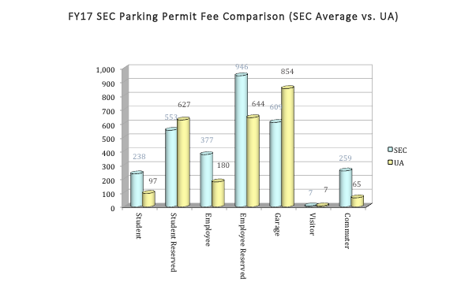
Parking Permits and Fees Comparison
Notes:
Fees vs. Other SEC Universities
- Reserved: Average
- Garage and Resident Reserved: Slightly Above Average
- All Else: Below Average

Slide 13
Evening Parking Options
5 to 8 pm Campus Core Lots
Permits Required
Meter Payment Required
Reserved Parking Spaces
2 Weeks Notice
Notes:
Evening Parking Options
Two 5-8pm options
Lots 7 and 8
Lots 4 and 5
Lot 61
During the day
5 to 8 pm: for any reserved OR faculty/ staff parking permit
Faculty who come back at night can park here

Slide 14
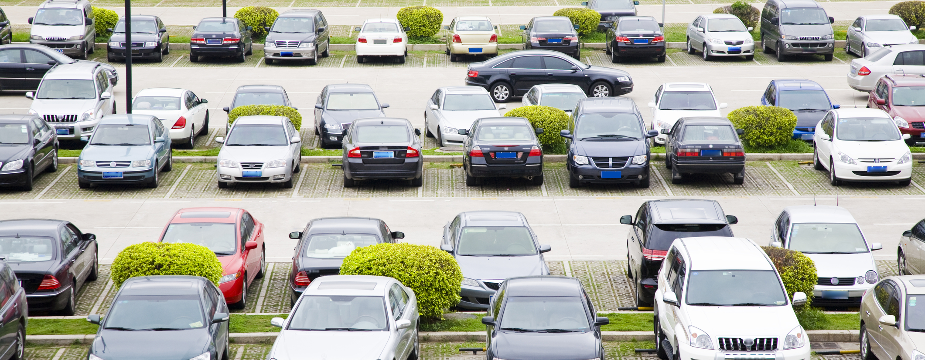
Recent Parking Changes
Notes:
Changes in Parking
Fall 2015: request to extend permit requirements until 8pm
parking for events at Faulkner Center
Permits are not required after 5 pm in Lots along Razorback Road
Head-in Parking
Change this year to park “head-in” first in the parking space
Allows us to see license plates faster and easier, esp. important in case of emergencies and need to contact you
Signs everywhere now, at every entrance to parking lots
Citations: 1st is a warning, 2nd is a citation (cost?)

Slide 15
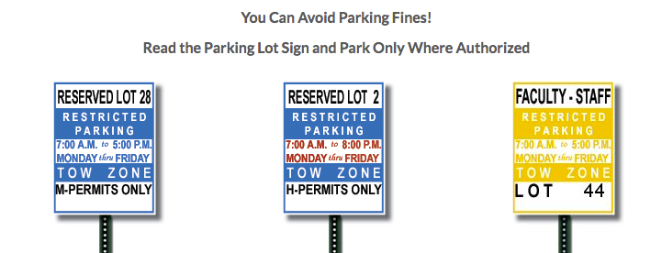
Parking Control and Enforcement
Notes:
Parking Control and Enforcement
Monday through Friday 7am to 10:30pm
Work athletic events
Weekends
If you always read the parking lot signs and park only where authorized, you can avoid a parking citation

Slide 16
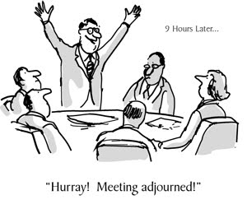
COMMITTEES
Transit, Parking and Traffic Committee
Appeals Committee
Notes:
Transit, Parking and Traffic Committee
made up of faculty, staff and students
sets fees and fines
decide which parking lot is designated for which group (“who parks where”)
Appeals Committee
made up of faculty, staff and students
40-50,000 citations per year
People feel they shouldn’t have been ticketed and this is the process
Committee decides on appeals process and judgment
Next one is coming up Sept. 26th

Slide 17
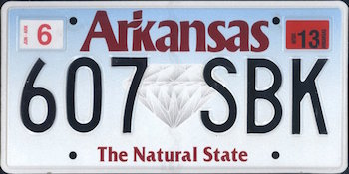
KEY INITIATIVE THIS YEAR: LPR
Notes:
LPR: What is it?
LPR stands for License Plate Recognition
From your perspective: LPR is doing away with physical parking permits
Your parking permit will be linked to a license plate or plates (up to 5 vehicles on one parking permit)

Slide 18
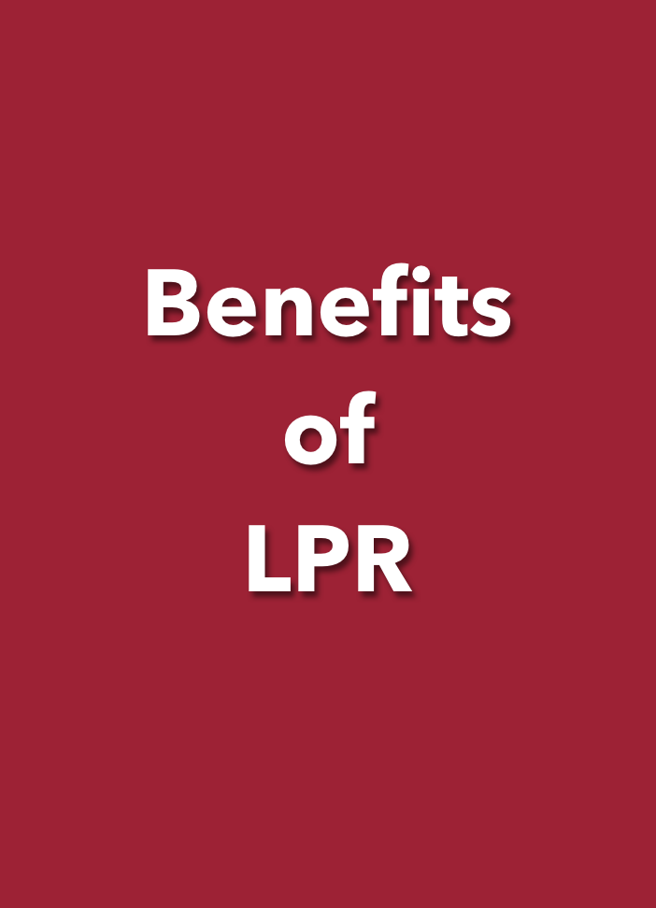
What You Will See
1. No physical parking permits to lose
2. Can activate up to 5 vehicles on one parking permit
3. Departments can pre-register guests’ vehicles
4. Multiple people can access department portal
5. Departments can request a URL for events
6. Online app called Whoosh! (Transit and Parking app coming later)
7. Parking citations delivered by email
Notes:
What You Will See
No physical parking permits to lose: linked to license plate or plates now virtually
Can activate up to 5 vehicles on one parking permit —No longer have to remember to transfer a physical parking permit to another car (if bring in rental car, can activate); only one car on campus at a time
Departments can order permits ahead of time
Multiple people can access department portal
Departments can arrange for large events with link
Online app called Whoosh! (and later Transit and Parking app coming)
Parking citations delivered by email Parking citations delivered by email: can log in and view all the info including photos, can pay online, and in the future, even appeal online
THERE ARE LOTS OF OTHER BENEFITS BUT WE’LL BE HERE ALL DAY

Slide 19
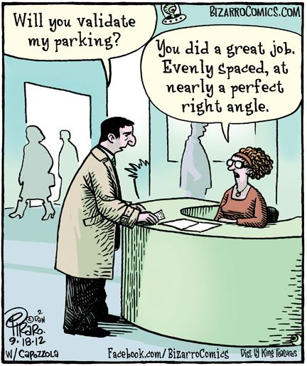
WHEN WILL LPR LAUNCH?
Notes:
LPR
Phase I: Currently we are still testing, testing and testing
Phase II: Smartphone app - can tell you where the parking spaces are available

Slide 20

Social Media: @UofATandP
Notes:
Follow us on social media to keep up with our latest news

Slide 21
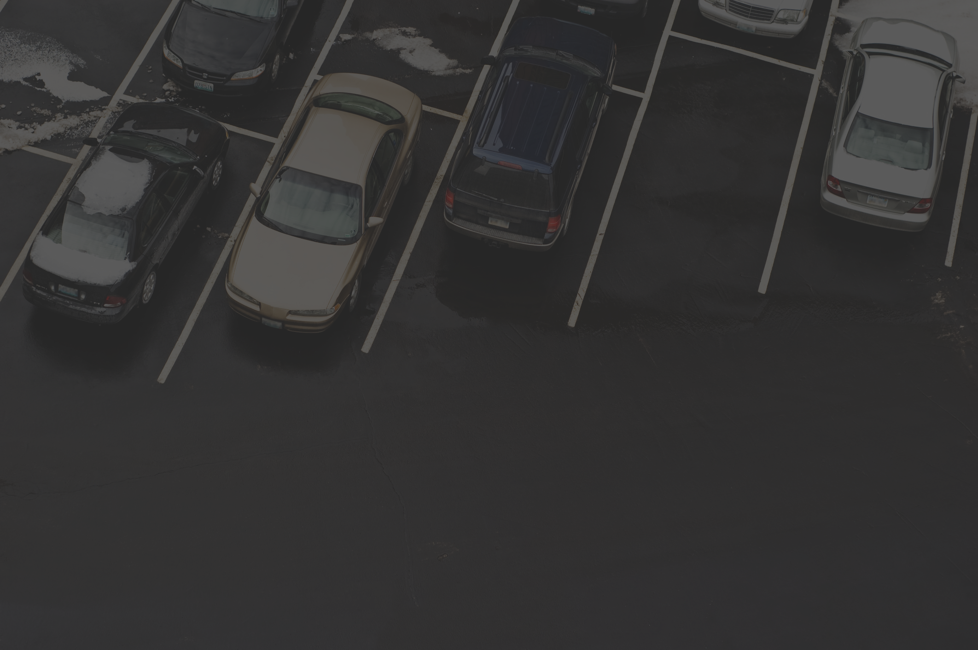
“You know, somebody actually complimented me on my driving today. They left a little note on the windscreen, it said, ‘Parking Fine.’
So that was nice.”
Tim Vine (comedian)

Slide 22
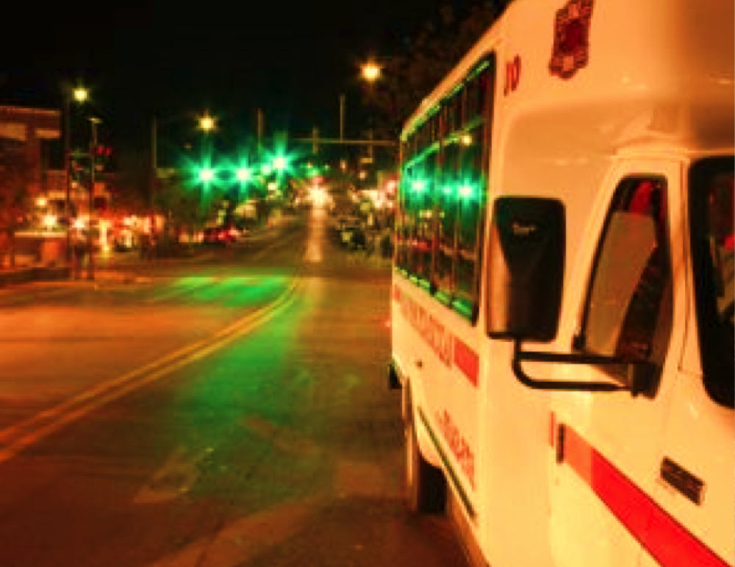
Thank You!
GARY SMITH
garys@uark.edu
(479) 575-3304

