Slide 1



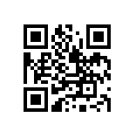

libraries.uark.edu/oer/
Ways we support your project:
Due Wednesday March 28, 2024
  Global Campus Instructional Design Support
  Research assistance
  Financial compensation
  Licensing guidance
  Accessibility review
  Technical assistance with Pressbooks (digital publishing platform)
  Structured milestones and check-ins
  Publicity on campus and beyond
Further questions? oer@uark.edu

