Slide 1
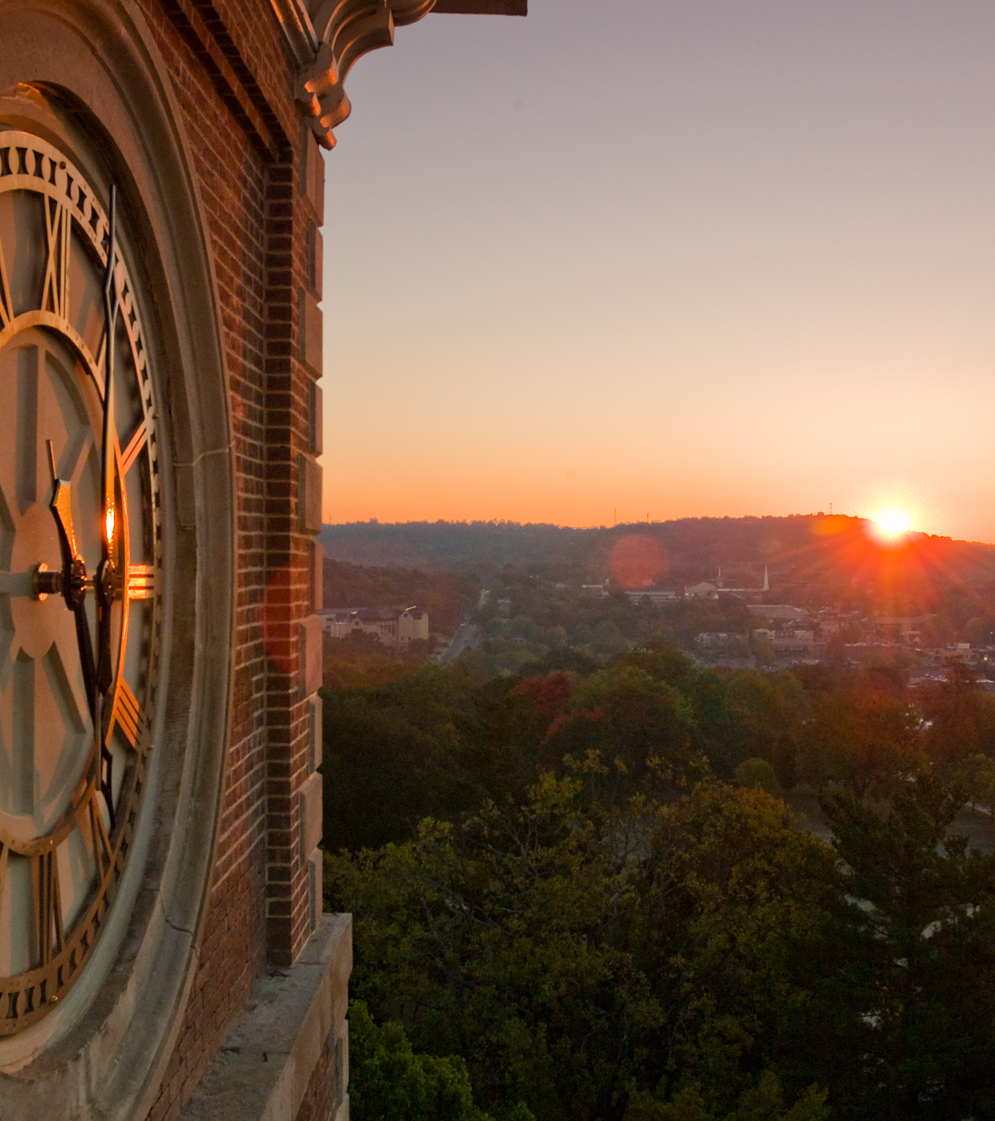
Academic Affairs Updates
Faculty Senate
September 11, 2024

Slide 2
Academic Affairs Agenda Items
1. Enrollment Update
2. Facilities Update
3. AI Taskforce
4. Blackboard Ultra Conversion
5. Turnitin Available
6. Instructional Modes Update
7. Clicker Update
8. New Classrooms – Stone and Rock House
9. Staff Compensation and Classification Study
10. Graduate Assistant Benchmarking Project
11. Faculty Compensation

Slide 3
Faculty Compensation Study

Slide 4
Market Analysis Approach — October 2023 to September 2024
.
COLLECT BENCHMARK DATA
.
VALIDATE APPROACH
.
LINK TO MARKET
.
DEFINE PATH FORWARD
.
Gathered data from two leading faculty compensation surveys, representing 82 institutions defined as U of A peers (see list)
Worked with UA Academic Colleges to identify CIP codes for each faculty member* based on teaching area and primary research area
Compare faculty compensation alignment to market data and create salary ranges for each academic rank and area
Identify faculty whose salary fell below the salary midpoint of the range identified by their academic rank and area in the compensation study
*Faculty with administrative titles of Chancellor, Vice Chancellor, Vice Provost, Dean, and Associate Dean were out of scope for the study

Slide 5
Academic Peer Set Survey Participation (1 of 2)
# | Institution | CUPA Survey | OSU Survey | State
1 | Auburn University | X | X | AL
2 | The University of Alabama | X | X | AL
3 | University of Alabama at Birmingham |  | X | AL
4 | University of Alabama in Huntsville | X |  | AL
5 | University of Arkansas |  | X | AR
6 | University of Arizona | X | X | AZ
7 | Arizona State University Campus Immersion | X | X | AZ
8 | University of Colorado Denver/Anschutz Medical Campus | X | X | CO
9 | University of Colorado Boulder | X |  | CO
10 | Colorado State University-Fort Collins | X | X | CO
11 | Colorado School of Mines | X | X | CO
12 | University of Connecticut | X |  | CT
13 | University of Delaware |  | X | DE
14 | Florida International University | X |  | FL
15 | University of Central Florida | X | X | FL
16 | University of Florida | X |  | FL
17 | University of South Florida | X | X | FL
18 | Florida State University |  | X | FL
19 | Georgia Institute of Technology-Main Campus |  | X | GA
20 | Georgia State University | X | X | GA
21 | University of Georgia |  | X | GA
22 | University of Iowa |  | X | IA
23 | Iowa State University |  | X | IA
24 | University of Illinois Urbana-Champaign | X | X | IL
25 | University of Illinois Chicago | X | X | IL
# | Institution | CUPA Survey | OSU Survey | State
26 | Purdue University-Main Campus |  | X | IN
27 | Indiana University-Bloomington |  | X | IN
28 | University of Kansas |  | X | KS
29 | Kansas State University | X | X | KS
30 | University of Louisville | X | X | KY
31 | University of Kentucky | X | X | KY
32 | Louisiana State University and Agricultural & Mechanical College | X | X | LA
33 | University of Louisiana at Lafayette | X |  | LA
34 | University of Massachusetts-Amherst | X | X | MA
35 | University of Maryland-College Park | X | X | MD
36 | University of Maryland-Baltimore County | X | X | MD
37 | University of Maine | X | X | ME
38 | Michigan State University |  | X | MI
39 | University of Michigan-Ann Arbor | X |  | MI
40 | Wayne State University |  | X | MI
41 | University of Minnesota-Twin Cities | X | X | MN
42 | University of Missouri-Columbia | X | X | MO
43 | University of Mississippi |  | X | MS
44 | University of Southern Mississippi | X | X | MS
45 | Mississippi State University | X | X | MS
46 | Montana State University | X | X | MT
47 | The University of Montana | X | X | MT
48 | University of North Carolina at Chapel Hill |  | X | NC
49 | North Carolina State University at Raleigh | X | X | NC
50 | North Dakota State University-Main Campus |  | X | ND

Slide 6
Academic Peer Set Survey Participation (2 of 2)
# | Institution | CUPA Survey | OSU Survey | State
51 | University of Nebraska-Lincoln |  | X | NE
52 | University of New Hampshire-Main Campus | X |  | NH
53 | University of New Mexico-Main Campus |  | X | NM
54 | University of Nevada-Reno | X | X | NV
55 | University of Nevada-Las Vegas | X | X | NV
56 | University of Cincinnati-Main Campus |  |  | OH
57 | Ohio State University-Main Campus |  |  | OH
58 | Ohio University-Main Campus | X | X | OH
59 | Kent State University at Kent | X | X | OH
60 | University of Oklahoma-Norman Campus | X |  | OK
61 | Oklahoma State University-Main Campus | X | X | OK
62 | Clemson University | X | X | SC
63 | University of South Carolina-Columbia | X | X | SC
64 | The University of Tennessee-Knoxville | X | X | TN
65 | University of Memphis | X |  | TN
66 | University of North Texas | X |  | TX
67 | The University of Texas at Austin |  | X | TX
68 | The University of Texas at Arlington | X | X | TX
69 | Texas A & M University-College Station |  | X | TX
70 | The University of Texas at Dallas | X |  | TX
71 | University of Houston | X | X | TX
72 | Texas Tech University |  | X | TX
73 | The University of Texas at San Antonio | X |  | TX
74 | The University of Texas at El Paso | X | X | TX
75 | Utah State University |  | X | UT
# | Institution | CUPA Survey | OSU Survey | State
76 | University of Utah |  | X | UT
77 | University of Virginia-Main Campus |  | X | VA
78 | Virginia Polytechnic Institute and State University |  | X | VA
79 | George Mason University | X |  | VA
80 | Old Dominion University | X |  | VA
81 | Virginia Commonwealth University | X |  | VA
82 | University of Wisconsin-Madison | X | X | WI
83 | University of Wisconsin-Milwaukee | X | X | WI
84 | West Virginia University | X | X | WV

Slide 7
Approach: Establishing Market Reference Point
CUPA-HR and OSU data sets from identified peer institutions were used to inform a U of A market reference point anchored to the CIP code and rank level of each faculty position, weighted by the number of institutions represented in each data set.
Example Position #1: Professor, 45.0601 (Economics, General.)
 | # of Peer Institutions Represented | Average (Mean) | Weighted Multiplier
CUPA-HR | 28 | $195,413 | 28/71
OSU | 43 | $215,572 | 43/71
U of A Market Midpoint: $207,622
Example Position #2: Associate Professor, 45.0601 (Economics, General.)
 | # of Peer Institutions Represented | Average (Mean) | Weighted Multiplier
CUPA-HR | 27 | $142,906 | 27/68
OSU | 41 | $147,290 | 41/68
U of A Market Midpoint: $145,549

Slide 8
Market Alignment by Rank and Tenure Status
Tenured professors and instructors make up the majority of individuals with salaries identified as below market.
Current State Average Market Index (93.6%)
Current State Average Market Index (82.4%)

Slide 9
Alignment on Academic Promotion Increases
Compensation increases for academic rank promotions have been adjusted based on market data.
Faculty Rank | Previous Promotion Increment | Promotion Increment effective July 1, 2024
Advanced Instructor |  | $1,250
Senior Instructor |  | $2,500
Associate Professor | $4,000 | $5,000
Professor | $9,000 | $10,000
University Professor | $9,500 | $10,000
Distinguished Professor | $10,000 | $10,000

Slide 10
Alignment on Faculty Pay Rates by CIP Code –
Establishing Market Rates
Within each CIP Code, each academic rank has a separate market rate (the midpoint of the range).
Department of Razorback Studies*
Faculty Rank | Market Rate
Instructor | $56,896
Assistant Professor (tenure-track) | $75,136
Assistant Professor (non-tenure-track) | $66,383
Associate Professor (tenured) | $92,516
Associate Professor (non-tenure-track) | $83,561
Professor (tenured) | $138,463
Professor (non-tenure-track) | $122,920
Distinguished and University Professor (tenured) | $155,079
*The chart is used for illustrative purposes only.

Slide 11
Aligning on Faculty Pay Rates by CIP Code – Applying Market Adjustment
Percentage Pay to Market Rate |  | Market Adjustment %
90% | 95% | 6%
85% | 90% | 7%
80% | 85% | 8%
75% | 80% | 9%
70% | 75% | 10%
65% | 70% | 11%
60% | 65% | 12%
55% | 60% | 13%
50% | 55% | 14%
0% | 50% | 15%

Slide 12
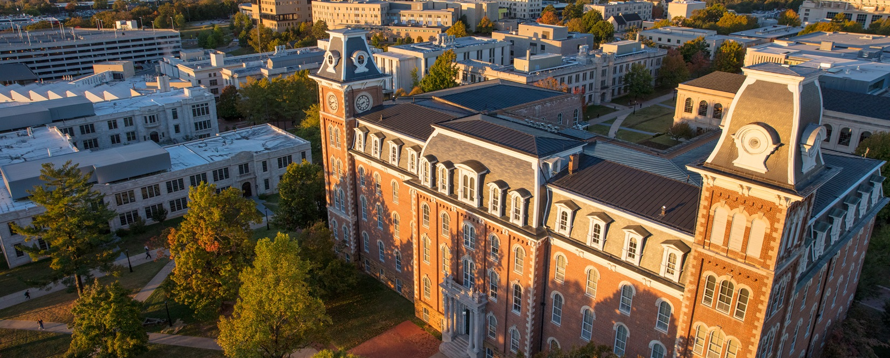
Questions?

