Slide 1
Faculty Senate October 9, 2019

Slide 2
Our Purpose
The purpose of the Global Campus is to work with units across the Fayetteville campus, industry and business leaders, and other institutions to provide access to educational opportunities that will help people advance in their careers or start new ones.

Slide 3
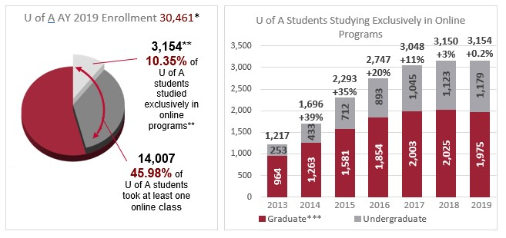
FY 2019 Online enrollments

Slide 4
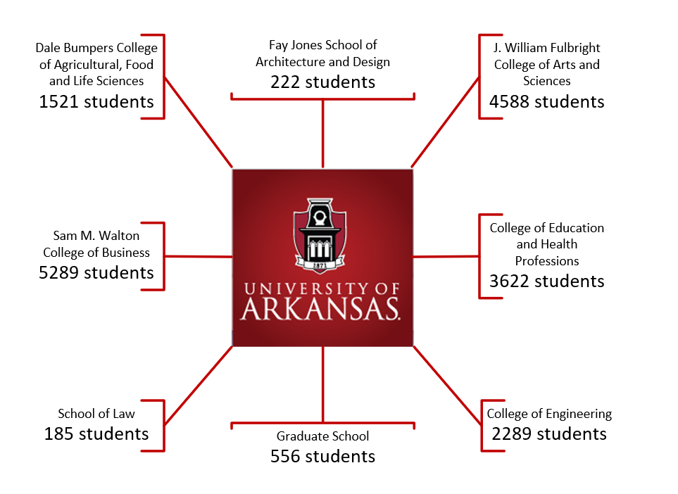
2019 Annual Report
Students taking at least one online course during the 2018-2019 academic year…

Slide 5
Online Course Development for FY 2019
 | New Online | Rebuilt Online | Rebuilt Self-Paced | Non- Credit | Total
Bumpers College | 5 |  |  |  | 5
College of Education & HP | 16 | 22 | 2 | 16 | 56
College of Engineering | 9 | 2 |  |  | 11
Fulbright College | 22 | 4 | 4 | 2 | 32
School of Law | 3 | 1 |  |  | 4
Walton College | 7 | 4 |  | 6 | 17
Total | 62 | 33 | 6 | 24 | 125

Slide 6
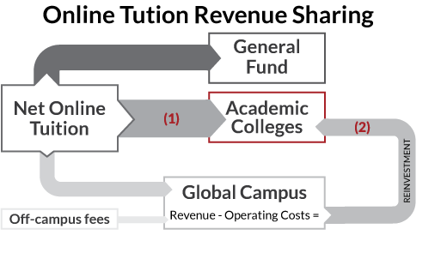
Online Tuition Revenue Sharing
Online educational revenues directly benefit the University through two pathways:
Net online tuition revenue is split between the colleges, General Fund, and GC.
GC, after defraying its operating costs, reinvests in colleges and schools.
In FY 2019, the Global Campus reinvested more than $650,000.

Slide 7
What’s Next? We are here to support…
Strategic development of new online programs;
Creation of career pathways which include micro-credentials that lead to certificates that lead to degrees;
Development of relationships with businesses and industry to provide specific educational opportunities for their employees;
Innovation in teaching and learning;
YOU!

