Slide 1
University of Arkansas Bookstore 616 N Garland Ave

Slide 2
GETTING COURSE MATERIALS IS EASY
RENT OR BUY course materials from UARK Bookstore and get...
THE RIGHT COURSE MATERIALS: We worked directly with your professors and departments to ensure the right course materials are available for all of your classes.
LARGEST SELECTION: Your course required course materials are available through University of Arkansas Bookstore in person or online at uark.bncollege.com.
PRICE MATCH: Rent or buy! We price match Amazon, bn.com and local competitors. See our website for complete details.
CONVENIENCE: Your Campus Store is right on campus. And fast, FREE in-store pickup is an available option with every online order as well as UPS shipping.
HASSLE-FREE RETURNS: Drop a class? Get a full refund if you need to return your book within 30 days.
GET CASH BACK: Your books may be eligible to sell back to us for cash.

Slide 3
BE PREPARED AND SAVE MONEY University of Arkansas
Inclusive Access/First Day Program
FIRST DAY®
GET AN EDGE ON ACADEMIC SUCCESS
All electronic learning materials are provided to you and the student before the first day of class. This helps ensure you have everything you need to get your semester off on the right foot.
SAVE MONEY
Students pay a standard materials charge with their tuition which
is 32% less on average than getting the books outside
the program.
REDUCE STRESS
We know you have a lot on your mind as you get started with classes, this program gives you one less thing to worry about!

Slide 4
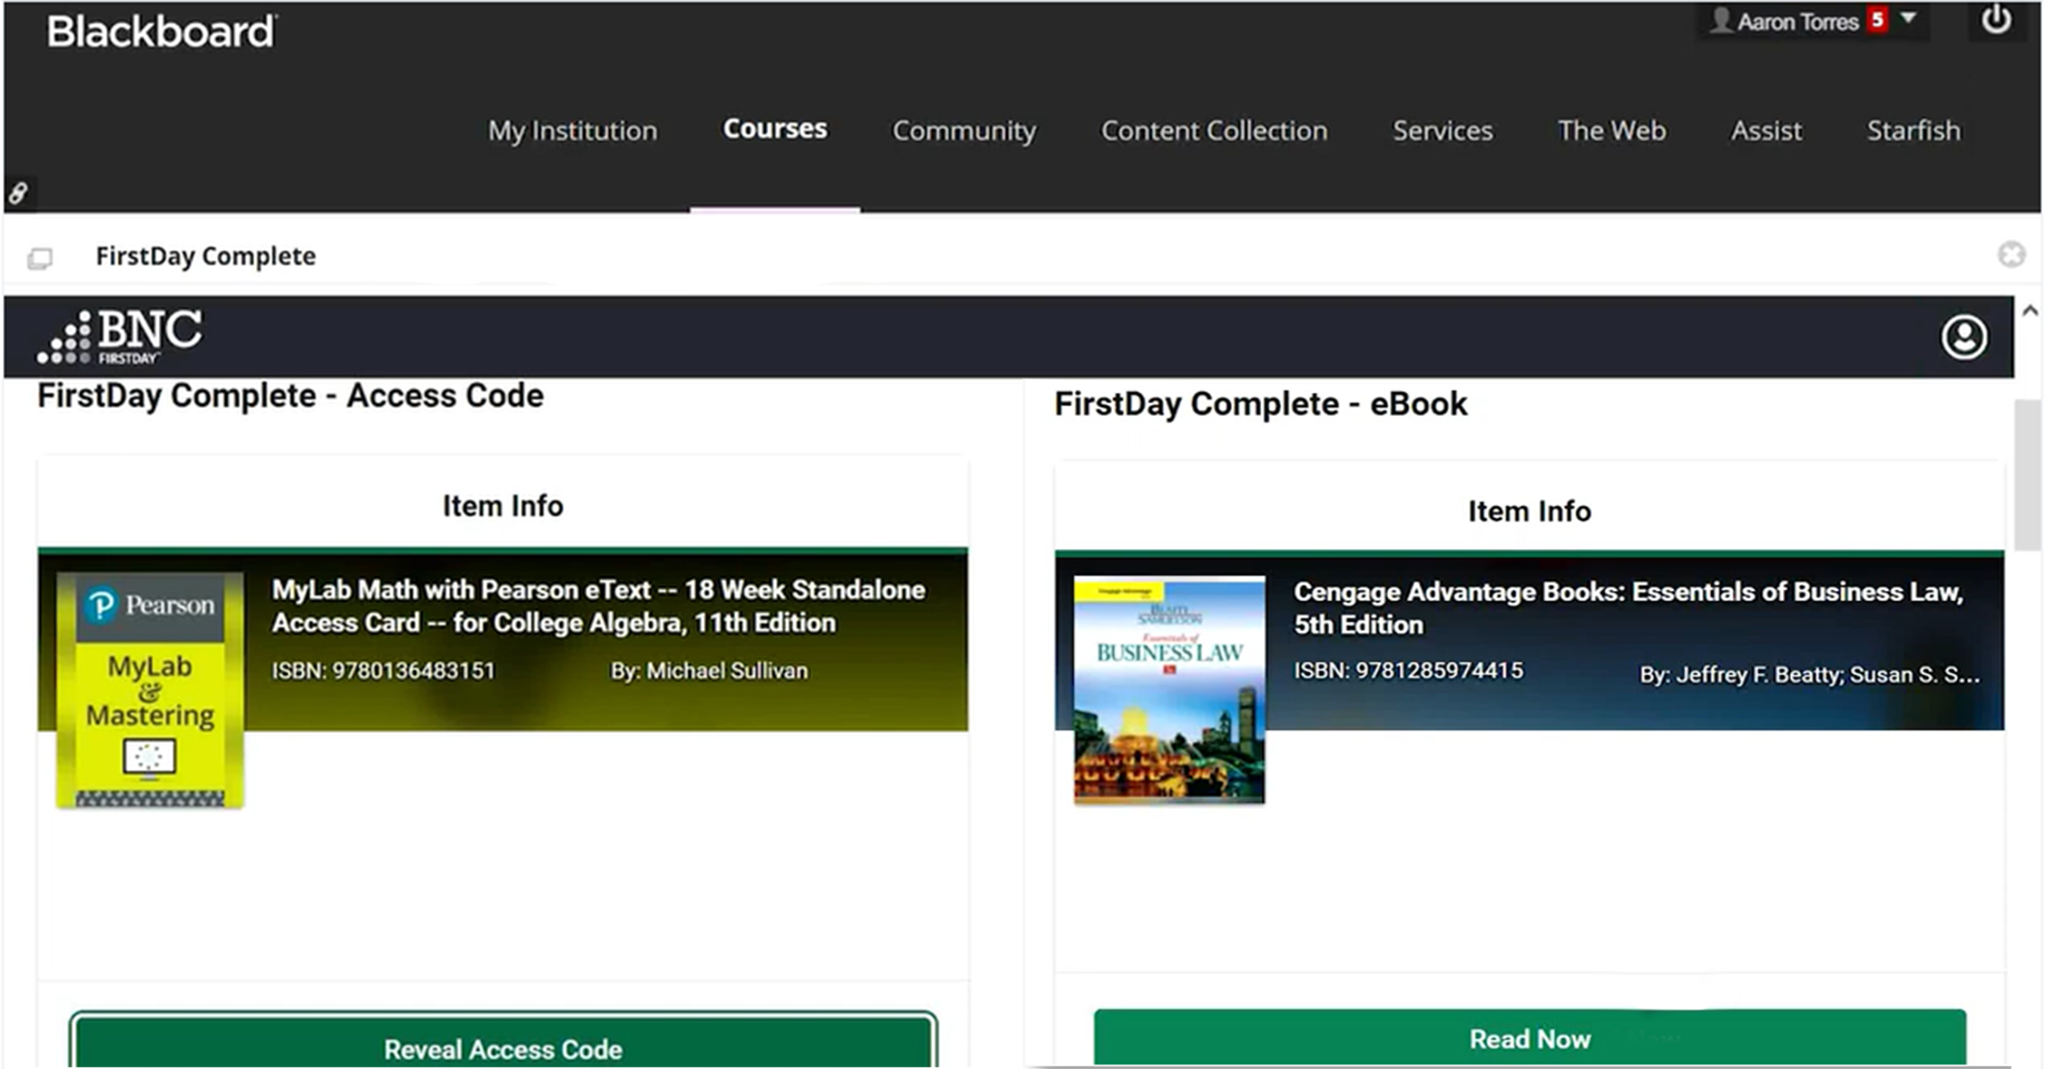
Digital Materials Delivered By the First Day
E-books
Publisher
Courseware
BNC OER+
Courseware
Notes:
All digital materials are delivered prior to the first day of class directly into the students LMS

Slide 5
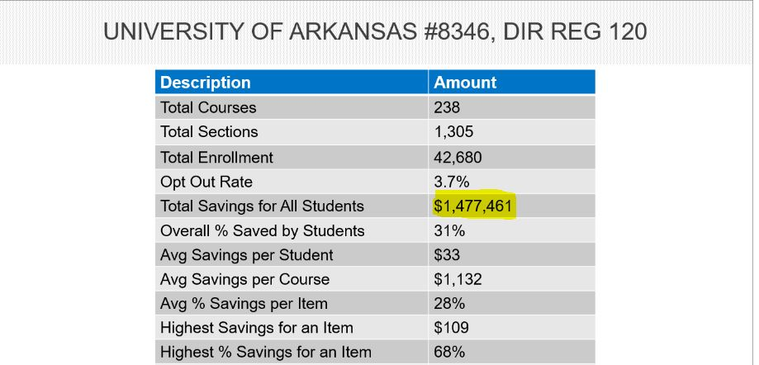
First Day Savings Fall 22

Slide 6
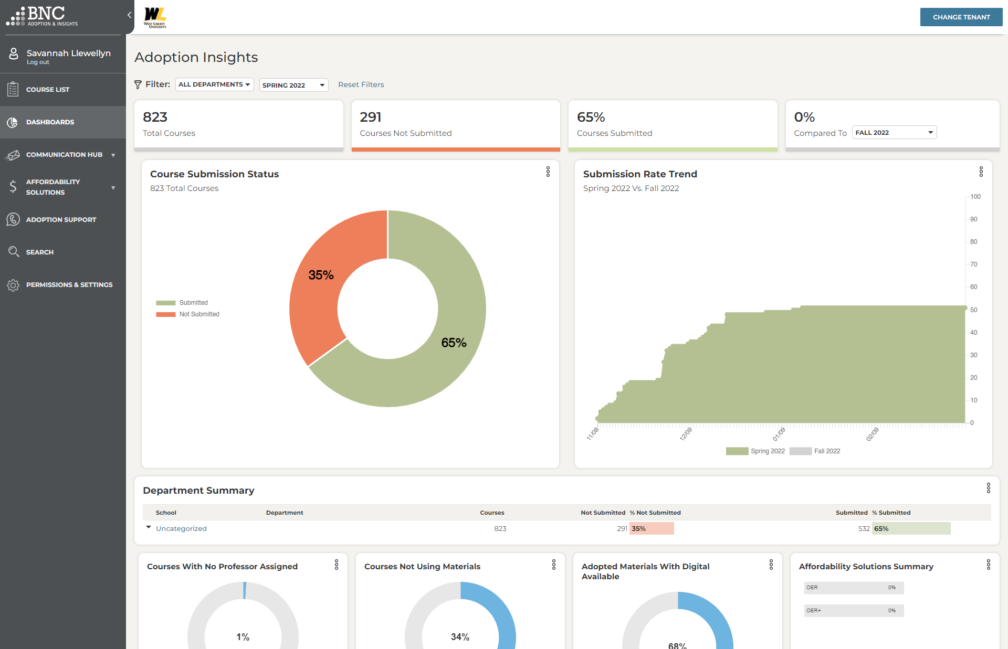
We Provide a Streamlined Faculty Experience
“Guide Me” with Integrated History, Search, and Recommendations
Adoption Insights with
High-Impact Reporting Dashboards By Class, Department & School
Affordability Solutions
like OER Options Featured
Powerful On-Demand & Trigger-Based Communication Tools
Industry’s First
One-Click Re-Adopt Functionality
Live Faculty Support
7 Days/Week
Via Chat/Phone
Notes:
We do provide a streamlined faculty adoption experience.
Demo
SWSI – MO and Lauren

